Slide 1
Microservices archteciture in cloud environment
Santhosh kumar.M(192511017)
Mohamed safeel.J(192324279)

Slide 2

The Monolith Trap
Historical Legacy
Large, tightly interconnected codebases demand full redeployment for even the smallest change — creating friction at every level of the development lifecycle.
The Breaking Point
As user demand grows, scaling becomes expensive and innovation slows. A single bottleneck can stall the entire organization's ability to ship value.
Notes:
2

Slide 3


Defining Microservices: The Modular Revolution
Core Concept
Break complex applications into small, independent services — each focused on a single business capability and owned by a dedicated team.
Philosophy
Each service owns its logic and data, communicating through well-defined APIs. No shared state, no hidden dependencies, no fragile coupling.
Think of it as replacing a single massive engine with many specialized, replaceable parts.
Notes:
3

Slide 4

Accelerating Agility
Development Velocity
1
Parallel workflows let independent teams deploy features daily without coordination overhead. Spotify releases updates continuously across hundreds of squads.
Tech Diversity
2
Teams choose the right tool for each job — Node.js for APIs, Go for high-throughput services, Python for data workloads — without forcing a single stack.
Notes:
4

Slide 5

Infrastructure & The Cloud-Native Stack
Containerization
Orchestration
Docker encapsulates each service with its dependencies, guaranteeing consistent behavior across dev, staging, and production environments.
Kubernetes automates deployment, horizontal scaling, self-healing, and rolling updates — the operating system of cloud-native infrastructure.
CI/CD Pipelines
Automated build, test, and deploy cycles enable teams to ship code safely and frequently, with zero-downtime releases as the standard.
Notes:
5

Slide 6
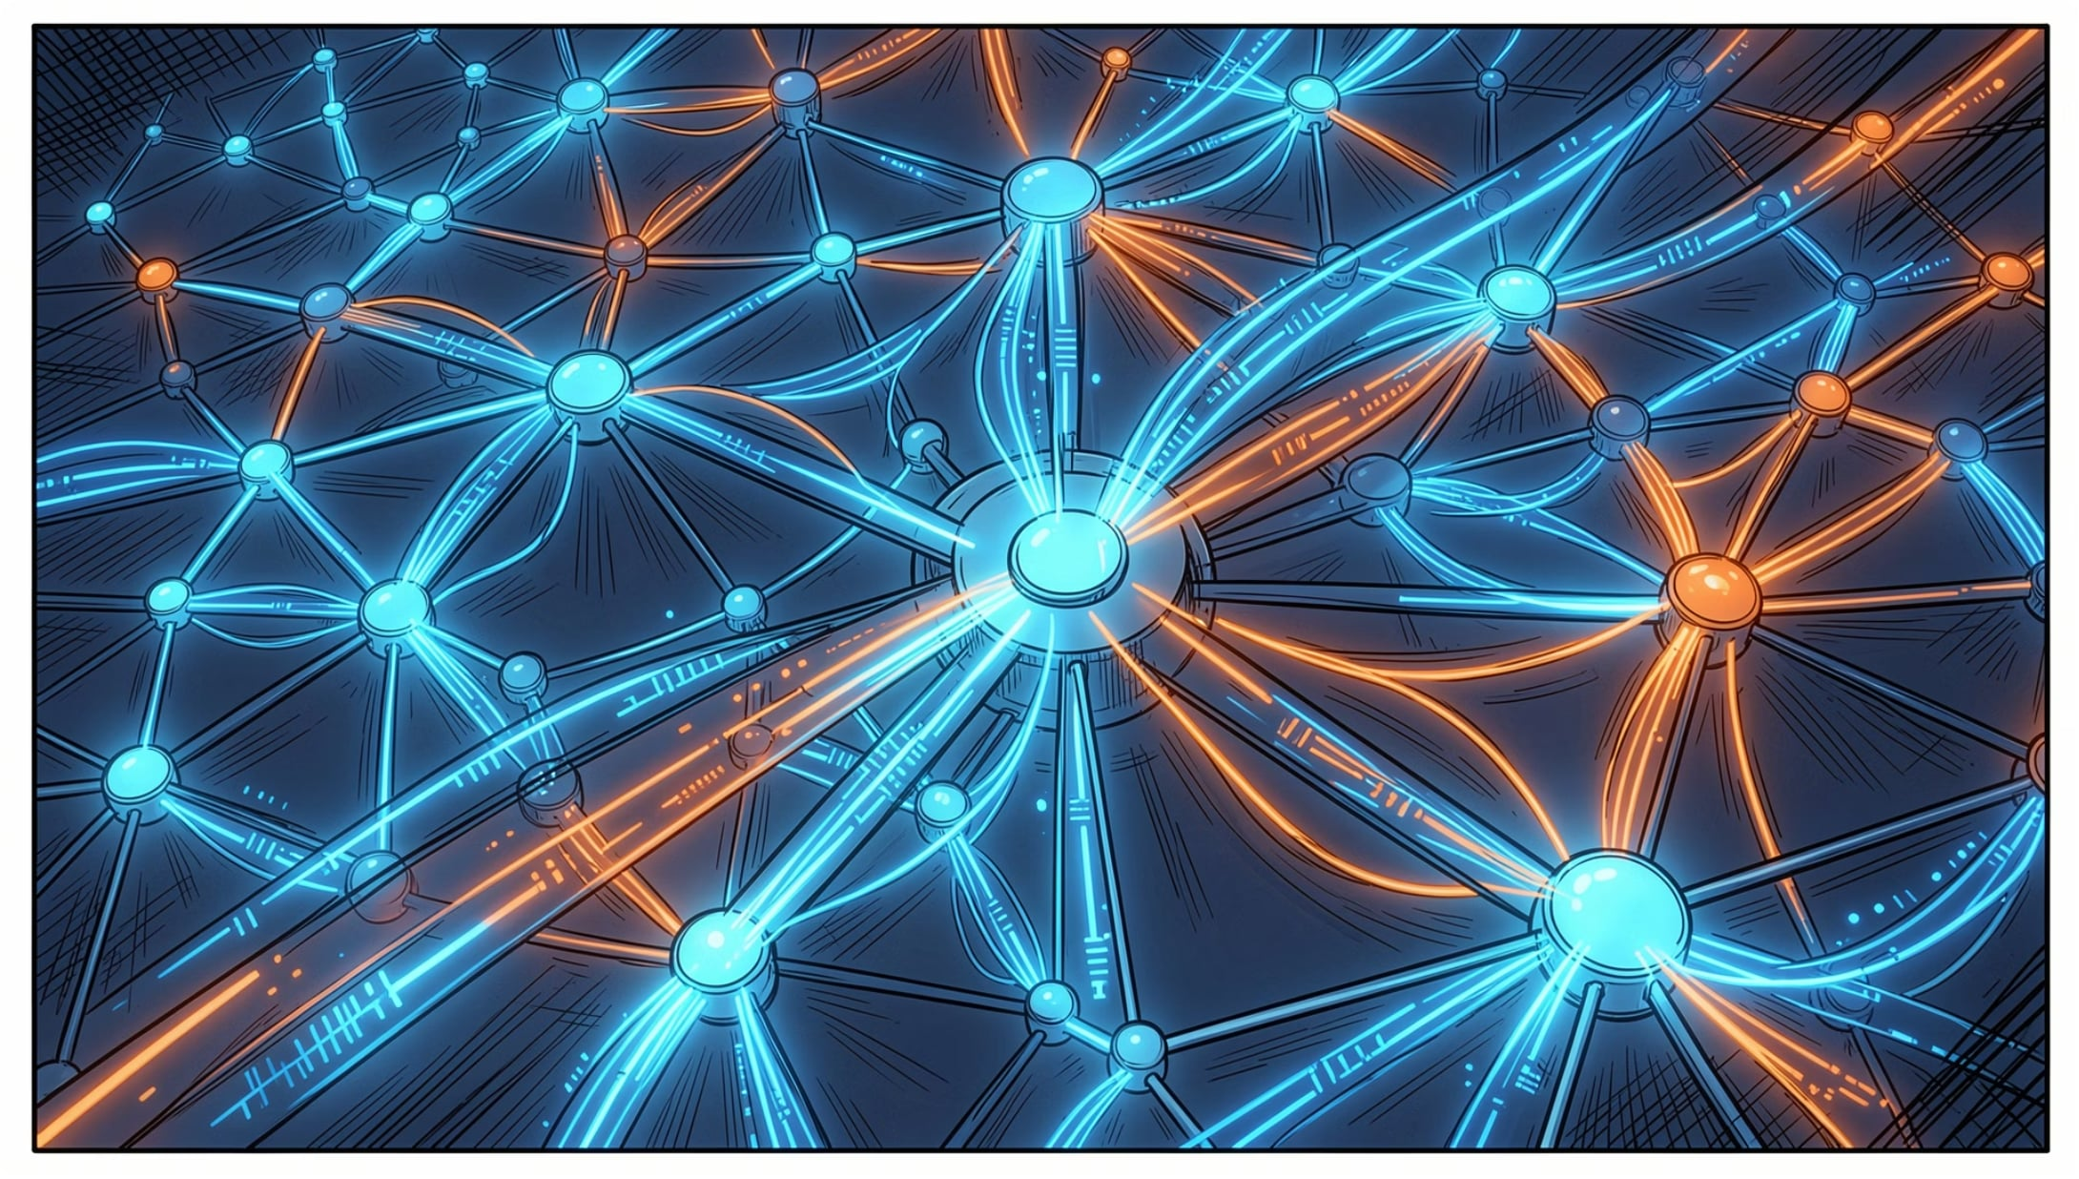

The Service Mesh: Managing Complexity
Control vs. Data Plane
Sidecar proxies like Envoy intercept all service-to-service traffic, handling encryption, authentication, and telemetry without changing application code.
Advanced Routing
Enable Canary releases and Blue/Green deployments to roll out changes to a fraction of users first — dramatically reducing release risk.
Istio and Linkerd are the leading service mesh implementations in production today.
Notes:
6

Slide 7
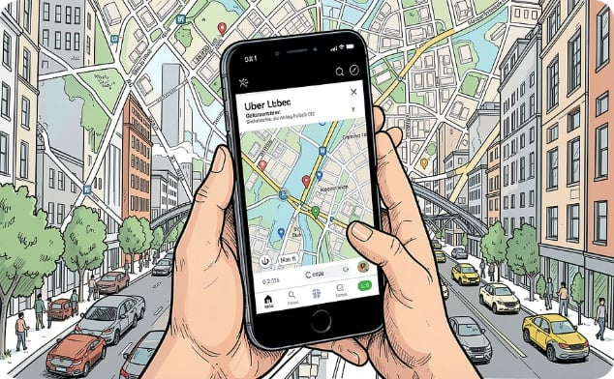


Industry Implementation: Real-World Transformations
Uber
Netflix
Spotify
Migrated from a monolithic dispatch system to thousands of microservices, enabling rapid feature rollout across 70+ countries and supporting massive global scale.
The cloud-native pioneer runs thousands of containers on AWS, delivering 99.99% uptime and serving 200M+ subscribers with independent, resilient services.
Organized into autonomous squads owning end-to-end services, enabling daily deployments and rapid experimentation at global scale.
Notes:
7

Slide 8
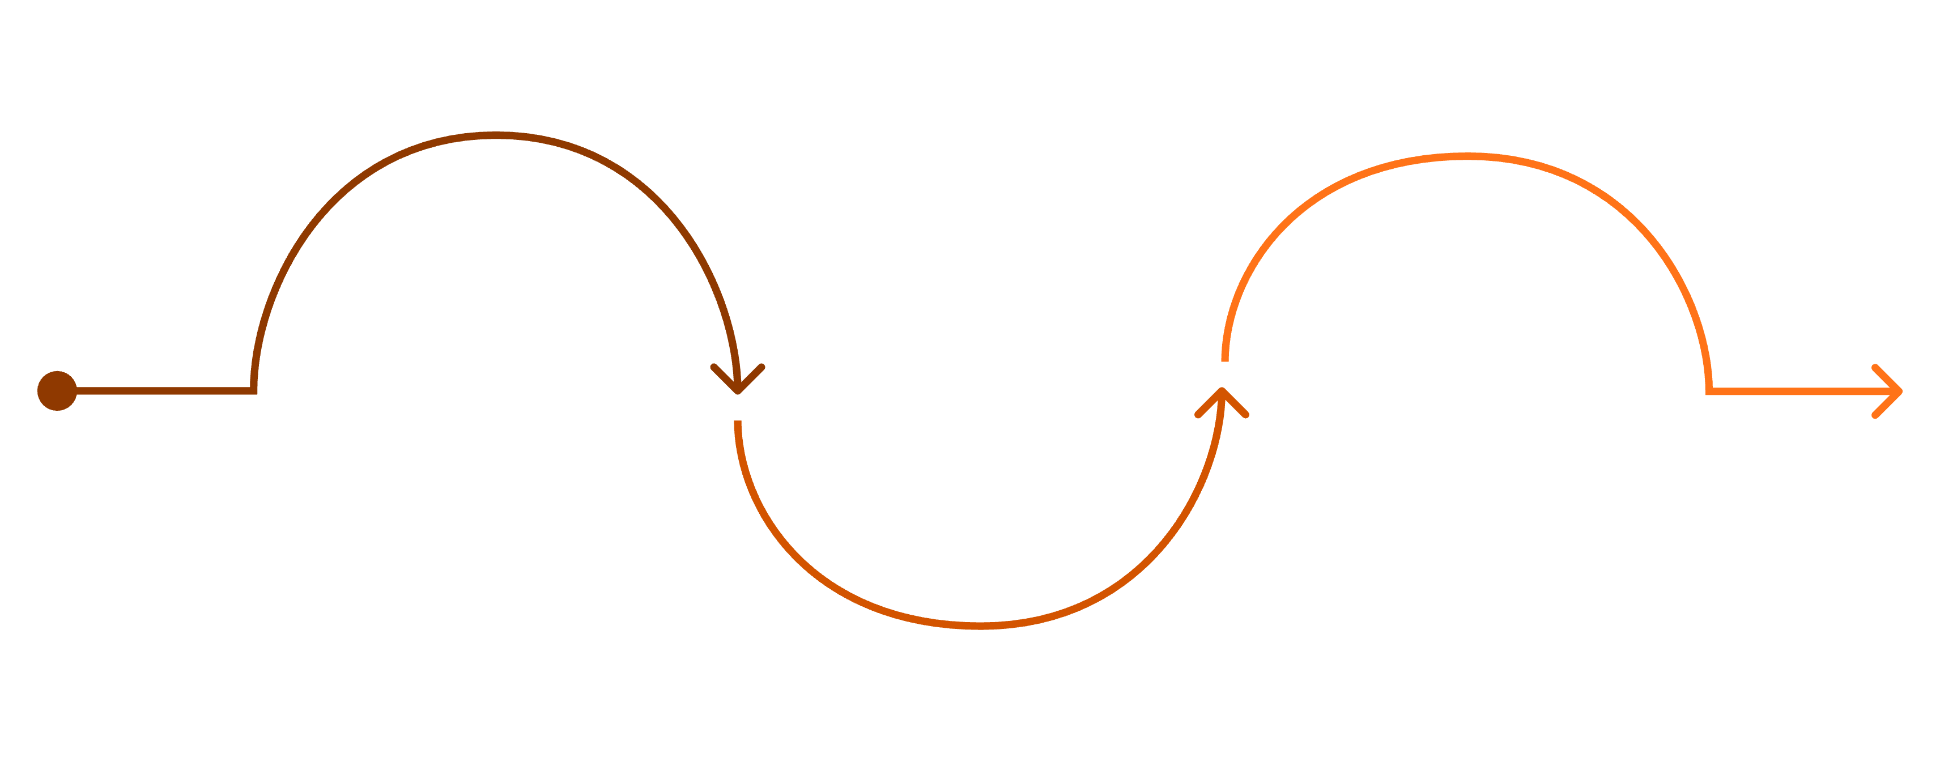
Conclusion: The Path Forward
Start Small
Evolve Continuously
Extract one bounded context and prove the model
Scale Gradually
Expand services and invest in observability & CI/CD
Embrace automation and a culture of adaptation
The journey is iterative — not a single leap but a deliberate evolution toward greater agility and resilience.
🎯 Start Small
🔭 Prioritize Observability
🔄 Build Culture
Identify one bounded context. Extract it. Learn. Iterate.
Invest in logging, tracing, and metrics from day one — you cannot improve what you cannot see.
Technology alone won't transform your organization. Foster a culture of ownership, automation, and continuous learning.
Notes:
8

Slide 9
THANK YOU

